Slide 1
Health Literacy in the Pediatric Transplant Population
KAT BROAD, MSW & DR. KATIE HAUBRICH, PHARMD
BC TRANSPLANT EDUCATION DAYS
OCTOBER 24TH 2023

Slide 2
Disclosure
No relevant current or past relationships with commercial entities to disclose

Slide 3
Land Acknowledgement
As we gather today on the unceded traditional territories of the xʷməθkʷəy̓əm (Musqueam), Sḵwx̱wú7mesh (Squamish), and səlilwətaɬ (Tsleil-Waututh) Nations, we invite you to consider the valuable lessons we can learn from indigenous societies and apply to our roles as communicators in the healthcare world:
the value of storytelling in teaching skills and transmitting knowledge
the importance of oral transmission of lessons and information
written information as a static record, oral discourse as a dialogue
the significance of collective knowledge and memory
Notes:
Katie: We would like to both acknowledge our position here as White settlers, and the inherent biases that carries, including the communication methods we default to. The colonial Western world has always placed great value on written word, and we challenge you today to consider the communication practices embedded within other cultures, including our indigenous societies.

Slide 4
Parent Perspective on Learning and Literacy
https://youtu.be/itVfXqqpW0Q
Notes:
Kat: Share the purpose of this work, impact on families

Slide 5
Objectives
1. Define health literacy and describe the relevance of screening in the transplant population
2. Compare commonly used tools to assess health literacy
3. Discuss the impact of health literacy on pediatric transplant clinical outcomes and interventions to support patients and families
Notes:
Kat:
Our objectives today are threefold:
Firstly to make sure you all walk away a solid understanding of health literacy and why it’s important to screen in the transplant population. Secondly to walk you through some of the screening tools used to assess health literacy, and finally to highlight the significance and impact of health literacy screening as it relates specifically to our pediatric transplant patients and families.

Slide 6
Outline
1. Background on health literacy
2. Health literacy assessment tools
3. Study results
4. Plans for future study
5. Implications for our MOT program
6. Patient Cases
7. Summary
Notes:
Kat:
Here’s a brief outline of our talk so you can stay on track with us, we’ll provide you with some background, introduce the tools commonly used for screening health literacy and share in greater detail the tool we use at BCCH, before walking your through our study and its implications for the program and pediatric transplant recipients. We’ll finish with some case examples to reflect upon and hopefully allow some time for questions/discussion.

Slide 7
Background
What is “health literacy?”
“the ability to access, understand, evaluate and communicate information as a way to promote, maintain and improve health in a variety of settings across the life-course.”
Public Health Agency of Canada (2017)
Notes:
Kat:
The best starting place we feel is to land at a definition for health literacy. The public health agency of canada states that health literacy is “the ability to access, understand, evaluate and communicate information as a way to promote, maintain and improve health in a variety of settings across the life course”.

Slide 8
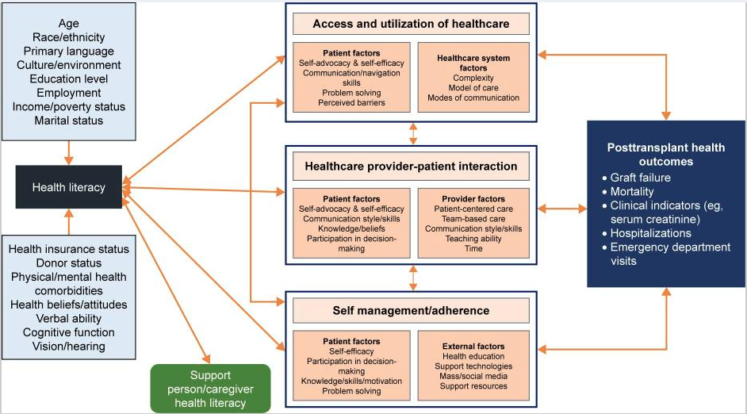
Patient Prefer Adherence. 2018; 12: 2325–2338.
Notes:
Kat-
So it should go without saying that optimizing health and wellness is a top priority for patients post solid organ transplantation. Low health literacy has important implications for health and wellness, and can lead to poor outcomes in solid organ transplant recipients. This slide is taken from a US study by Chisholm- Burns, Spivey & Pickett and provides a visual representation of the way in which health literacy is formed and its relationship with the broader health context. On the Left you can see that socio-demographics such as age, income, culture, education level inform health literacy as does one’s access to health care, physical and mental health comorbidities, as well as physical and cognitive abilities (such as hearing, vision and verbal and/or neuro-cognitive ability and diagnoses). And from here health literacy impacts reciprocally a patient’s ability to navigate, access and utilize the health care system, the relationship with and between patient and health care providers, and their ability to self manage and adhere to their transplant care. Note that the support of caregivers and close support people also influence reciprocally the patient - which is especially true in pediatrics but also in adult care- people we care about influence and shape our understanding and values around health so also cannot be overlooked in thinking about health literacy.
Above: Health Literacy Model in Transplantation (HeaL-T)🡪 to visually demonstrate the relationships among variable associated with health literacy

Slide 9
Background
Low health literacy is common
Estimated 55% of adult Canadians have below adequate health literacy
Among studies of adult solid-organ transplant recipients, low health literacy reported in 9% to 72% of patients
Public Health Agency of Canada (2017)
Patient Prefer Adherence. 2018; 12: 2325–2338
Notes:
Kat: So Low literacy IS common. According to a study from the Public Health Agency of canada, an estimated 55% of adult canadians have below adequate health literacy. Studies of solid organ transplant recipients found that low literacy accounted for 9-72% of patients.

Slide 10
Background
Intuitively assessing health literacy is difficult:
Limited health literacy may not be obvious in conversation with patients or families
Education level is a poor proxy for health literacy
Healthcare providers are poor predictors of their own patient’s health literacy
Typically OVER-estimate the literacy levels of their patients
Int J Environ Res Public Health. 2020 Apr; 17(7): 2372.
Notes:
Kat: But what we know is that intuitive assessing health literacy is difficult, often relying upon clinical impressions, assumptions and judgements. Low literacy is not easy to catch in routine clinical encounters. Health professionals struggle to differentiate between basic LITERACY, and health literacy. Education level is often the leading assumption to inform health literacy but it is actually a very poor proxy. Typically health care providers tend to over-estimate the health literacy of their patients, and are not reliable assessors of their patient’s own health literacy.

Slide 11
2020 SR: Agreement between Patients’ & HCP Assessment of Patients’ Health Literacy
Study | Overestimation | Underestimation | Kappa Statistic
Dickens et al. 2013 | 22% | Not reported | κ = 0.09
Kelly & Haidet 2007 | 25% | 15% | κ = 0.19
Lindau et al. 2006 | Not reported | Not reported | κ = 0.43
Rogers et al. 2006 | 53% | 25% | Not reported
Storms et al. 2019 | 34% | 5% | κ = 0.033
Zawilinski et al. 2019 | 58% | 29% | κ = 0.13
Int J Environ Res Public Health. 2020 Apr; 17(7): 2372.
Notes:
Katie: To highlight this point, we’ve shared here the result of a systematic review published in 2020, which included 6 studies looking at health care provider assessments of patient health literacy. You can see from this chart that in the majority of studies, health care professionals over-estimated patient health literacy levels, and that the inter-rater variability between health care providers (kappa statistic) shows low agreement. This data shows that we not only have a tendency to over-estimate patient health literacy as health care providers, but that between us, we are inconsistent in how we perceive patient health literacy.

Slide 12
Patient Prefer Adherence. 2018; 12: 2325–2338.
Notes:
Katie: Kat introduced all of the various factors that play into health literacy, and we’d now like to shift the focus of our discussion to explore how health literacy impacts our patients with transplants, specifically, and looking at post-transplant outcomes such as graft survival, health care utilization and mortality.

Slide 13
Health Literacy in Adult SOT
Low health literacy is consistently associated with negative patient outcomes in adult patients with SOT:
Kidney transplant:
increased serum creatinine levels
increased risk of mortality
increased emergency department use and hospitalization
Liver transplant:
increased post-transplant hospitalization
increased “medication tradeoffs” (ie. choosing between spending money on medications vs other essential costs)
Patient Prefer Adherence. 2018; 12: 2325–2338.
Notes:
Katie: In studies of adult transplant recipients, results have shown that low health literacy is consistently associated with negative health outcomes.

Slide 14
Health Literacy in Pediatric Patients
Low caregiver health literacy or numeracy has been associated with:
increased rates of emergency department visits and hospitalizations in children with asthma
higher frequency of non-urgent emergency department visits in the general pediatric population
medication dosing errors
misunderstanding of medication instructions
inappropriate use of over-the-counter products
Chest. 2013 Jul;144(1):92–8
J Ambul Pediatr Assoc. 2007 Feb;7(1):25–31.
Pediatr Emerg Care. 2011 Jun;27(6):469–74
Acad Pediatr. 2014 Jun;14(3):309–14.
Arch Pediatr Adolesc Med. 2010 ;164(2):181–6.
Pediatrics. 2014 Aug;134(2):e354–61
Fam Med. 2009 Dec;41(10):715–21.
Pediatrics. 2009 Jun;123(6):1464–71.
Notes:
Katie: in the general pediatric patient population, a number of studies have shown negative impacts of low caregiver health literacy, inlcuding:

Slide 15
Health Literacy in Pediatric Patients with SOT
Little is known about health literacy in pediatric patients and families referred for transplant, or post-transplant
In children with liver transplants, parental health literacy scores significantly correlated with:
number of biopsy-proven rejection episodes
number of hospitalizations
The clinical significance of limited caregiver health literacy in the context of pediatric kidney transplantation has not been studied
Pediatr Transplant. 2020;24:e13726
Notes:
Katie: Unfortunately, there is very little literature exploring the impact of health literacy on health outcomes in pediatric patients with transplants.

Slide 16
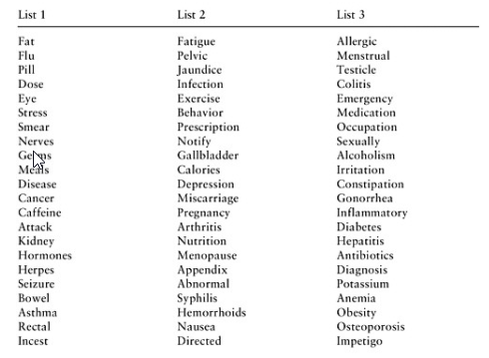
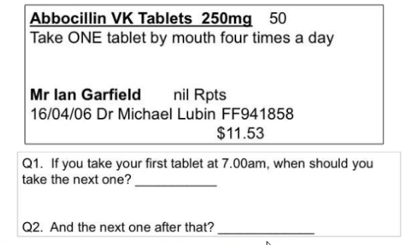
Health Literacy Assessment Tools
Fam Med, 1991
J Gen Int Med, 1995
Notes:
Katie: So how do we go about assessing health literacy in our patients and caregivers? There are a number of different validated tools to assess aspects of health literacy including reading comprehension, like this list of health-care related words, for example, or questions to assess prose comprehension or numeric literacy, such as this question about “abbocillin” medication dosing times, and understanding when your next dose of medication is due based on when your last dose was taken.

Slide 17
Validated Health Literacy Screening Tools Used in Research
REALM REALM-R | Reading comprehension test 125 (66 in –R) health-related words | Validated in US ~50% black, 50% white subjects 18-64 yrs | Word recognition and pronunciation Does not assess health-related quantitative skills 5-6 mins to administer Heavily studied, most commonly used measure in research
TOFHLA S-TOFHLA | 36 comprehension questions 4 numeric calculations | Validated in US 94% black subjects 18-64 yrs | Prose comprehension and numeracy Limited ability to detect poor numeracy 12-22 mins to administer
NVS | Simulated nutrition label 6 questions | Validated in US 93% white subjects 18-64 yrs | Reading skill, comprehension and numeracy 3-5 mins to administer Limited empirical support
Notes:
Katie: the 3 most commonly used and validated health literacy tools are the REALM (rapid estimate of adult literacy in medicine), TOFHLA (test of functional health literacy in adults) and the Newest Vital Sign, or NVS.
All 3 tools were validated in an American population, in primarily black and white subjects, and measure slightly different aspects of health literacy. They are meant to be relatively fast to administer so that they can easily be incorporated into clinical practice.
The REALM and TOFHLA tools have been available for much longer (validated in the early 90s), compared to the NVS tool, which was published in 2005, so the NVS tools has much more limited empirical support by comparison, but there is a growing body of research incorporating its use.

Slide 18
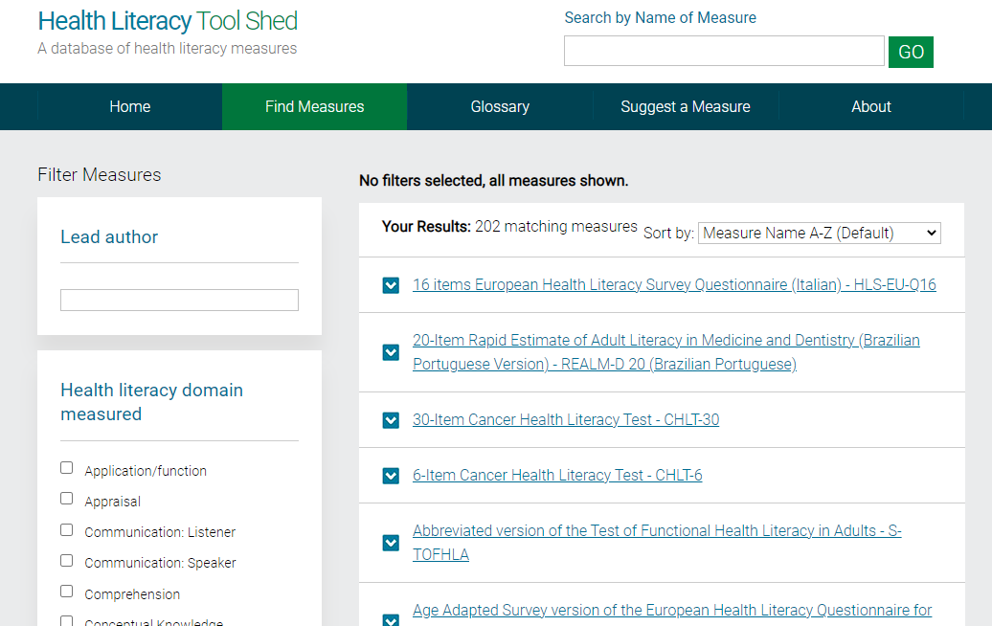
Notes:
Katie: the health literacy toolshed is excellent online resource with information about health literacy assessment tools, including tools that have been published and since validated in other languages; the newest vital sign, for example is available in Dutch, Portuguese, Italian, Chinese, Spanish, and sign language.

Slide 19
The “Newest Vital Sign” (NVS)
Validated screening test
6 verbally administered questions
Uses an ice cream nutrition label to assess health literacy and numeracy
Nutrition labels are familiar items that are important parts of health management for many chronic diseases
~ 3 minutes to administer
Provides higher sensitivity than the TOFHLA for detecting marginal health literacy
Annals of Family Medicine, 2005
Notes:
Kat: The Newest Vital Sign was designed by Weiss in 2005 to assess patient risk of low health literacy. It is validated in both English and Spanish ad involves asking 6 questions in reference to an icecream nutritional label. It takes about 3 minutes to administer and known to provide higher sensitivity for detecting marginal health literacy than the TOFHLA.
The probability of a person having limited health literacy is estimated by counting how many of the six questions are answered correctly. With 0-1 correct answers, people are scored as having a high likelihood of limited health literacy. With 2-3 correct answers, a person has a possibility of limited health literacy. A score of 4-6 correct answers almost always indicates adequate health literacy when using the TOFLHA as the standard reference standard.
The NVS is a free tool available online. It provides instructions for the interviewer and is designed to be administered verbally, with opportunities for patients to use pens/pencils and even calculators if they need to respond to each question.
he probability of a person having limited health literacy is estimated by counting how many of the six questions are answered correctly. With 0 to 1 correct answers, people are scored as having a high likelihood (50% or more) of limited health literacy. With 2 to 3 correct answers, a person has a possibility of limited health literacy. A score of 4 to 6 almost always indicates adequate health literacy using the Test of Functional Health Literacy in Adults as the reference standard

Slide 20
Grab your devices!
https://www.researchgate.net/figure/The-Newest-Vital-Sign-NVS-screening-instrument-for-health-literacy-The-Newest-Vital_fig1_51106767
Notes:
So for a bit of fun, I’m going to administer the NVS live to you all, hopefully acting as a guide for administering in a clinical setting also.
Ideally the NVS is administered at the same time other routine vitals or assessments are taken. In our clinic this is adminstered during pre-transplant assessments by either myself as the social worker, or our pharmacist, Katie.
The NVS provides a script as follows “ We are asking our patients to help us learn how well patients can understand the medical information that the healthcare team give them. Would you be willing to help us by looking at some health information and then answering a few questions about that information? Your answers will help our team learn how to provide medical information in ways that patients will understand. It will only take about 3 minutes.”
1. If you eat the entire container, how many calories will you eat? Answer: 1,000 is the only correct answer 2. If you are allowed to eat 60 grams of carbohydrates as a snack, how much ice cream could you have? Answer: Any of the following is correct: 1 cup (or any amount up to 1 cup), half the container. Note: If patient answers “two servings,” ask “How much ice cream would that be if you were to measure it into a bowl?” 3. Your doctor advises you to reduce the amount of saturated fat in your diet. You usually have 42 g of saturated fat each day, which includes one serving of ice cream. If you stop eating ice cream, how many grams of saturated fat would you be consuming each day? Answer: 33 is the only correct answer 4. If you usually eat 2,500 calories in a day, what percentage of your daily value of calories will you be eating if you eat one serving. READ TO SUBJECT: Pretend that you are allergic to the following substances: penicillin, peanuts, latex gloves, and bee stings. 5. Is it safe for you to eat this ice cream? Answer: No 6. (Ask only if the patient responds “no” to question 5): Why not? Answer: Because it has peanut oil.
How was that?
There is no maximum time allowed to answer the questions. The average time needed to complete all 6 questions is about 3 minutes. However, if a patient is still struggling with the first or second question after 2 or 3 minutes, the likelihood is that the patient has limited literacy and you can stop the assessment. Ask the questions in sequence. Continue even if the patient gets the first few questions wrong. However, if question 5 is answered incorrectly, do not ask question 6. You can stop asking questions if a patient gets the first four correct. With four correct responses, the patient almost certainly has adequate literacy. Do not prompt patients who are unable to answer a question. Prompting may jeopardize the accuracy of the test. Just say, “Well, then let’s go on to the next question.” Do not show the score sheet to patients. If they ask to see it, tell them that “I can’t show it to you because it contains the answers, and showing you the answers spoils the whole point of asking you the questions.” Do not tell patients if they have answered correctly or incorrectly. If patients ask, say something like: “I can’t show you the answers till you are finished, but for now you are doing fine. Now let’s go on to the next question.”
Poll live on cell phones.

Slide 21
The “Newest Vital Sign (NVS)”
NVS Assessment Areas |  | Applications to Post-Transplant Care
Numeracy skills | multiplication, converting to percentage | tacrolimus or prednisone dose adjustments using different strengths of tablet or liquid medication concentrations
Locate-the-information skill | reading comprehension and application, eg. “servings per container” vs “serving size” | understanding emails, handouts or instructions from the care team about bloodwork, diet changes, medication changes
Abstract reasoning skill | imagining allergy to peanuts, noting that ice cream contains peanut oil and reasoning that ice cream should not be consumed due to allergy | identifying food/beverage products that may contain grapefruit (contraindicated with tacrolimus) identifying that they are immunosuppressed and may not use certain products as a result (eg. some live vaccines)
Notes:
Kat: So why use the NVS?
A patient’s ability to read and analyze any kind of nutrition label requires the same analytical and conceptual skills that are needed to understand and follow a provider’s medical instructions. The skills required, target the understanding and application of words (prose), numbers (numeracy), and forms (documents). You can see that these skills are required as part of patient’s self management, such as making tacrolimus or prednisone adjustments, to comprehending instructions in an email about bloodwork results and action plans, to abstract reasoning such as identifying dangers associated to contraindicated dietary products like grapefruit.

Slide 22
Health Literacy Screening in the BCCH MOT Program
Initiated NVS literacy screening as standard of care for all appropriate kidney pre-transplant assessments as of 2020
Conducted “catch-up” assessments for families who were waitlisted for transplant, and those recently transplanted (January 2019 onwards)
In process of integrating broader health literacy screening for all organ pre-transplant assessments (liver, heart, lung)
Notes:
Kat: We initiated the screening of patients as part of routine clinical care during the social work or pharmacy part of the team’s comprehensive pre-transplant assessment in 2020. We prioritized screening our newer kidney transplants, and played some catch up with our screening but are hopeful to expend this to the broader post transplant population we serve including the liver, heart and lung transplant recipient.

Slide 23
HELP-KIDNEY
"Health literacy and patient outcomes in pediatric kidney transplant”
Design:
Single-center retrospective cohort
Notes:
Katie: In implementing health literacy screening in our population, we acknowledged that a significant gap in the literature exists around the association between health literacy and outcomes in pediatric patients with transplant. We sought to answer some questions about this impact by performing a retrospective study of our population, in the “health literacy and patient outcomes in pediatric kidney transplant, or “HELP-KIDNEY” study.

Slide 24
Study Objective
HELP-KIDNEY
To determine if a relationship exists between caregiver or patient health literacy and:
Healthcare utilization
as measured by frequency of tertiary-care visits & days hospitalized
Allograft outcome
as measured by relative change in SCr in the first years post kidney transplant
Notes:
Katie

Slide 25
Study Population
HELP-KIDNEY
Inclusion:
Patients aged ≤20 years old
Recipient of a kidney transplant and health literacy assessment at BC Children’s Hospital between Jan 2018 and Dec 2022
Exclusion:
Transplanted at other centers
Non-kidney transplant recipients
Immediate graft loss post-transplant
Non-English-speaking families requiring interpreter
Notes:
Katie: Screening conducted with parent/caregiver, unless patient ≥18 y.o and no identified learning or intellectual disability

Slide 26
Outcomes
HELP-KIDNEY
Hospital and outpatient visits at 3 and 12 months post-transplant
Days in hospital at 12 months post-transplant
Relative change in SCr between 12 and 24 months post-transplant
Notes:
Katie: the outcomes we have explored to date, include:

Slide 27
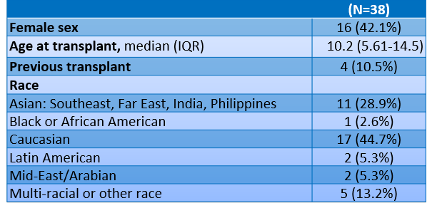
Patient Characteristics
HELP-KIDNEY
Notes:
Katie: Since routine health literacy screening had only been implemented for a couple of years at the time we conducted this retrospective review, we were able to include on a small sample of patient, 38 total. The majority of these patients were male, and were receiving their first transplant. The median age of the patient at time of screening was approximately 10 years, and patients were predominantly of white or asian race.

Slide 28
Results
HELP-KIDNEY
Caregiver and patient NVS literacy assessment
Notes:
The results of the caregiver and patient NVS assessments showed that the majority, approximately 58% of our population demonstrated “adequate literacy.” A small proportion of approx 10% was assessed as having a high likelihood of limited literacy

Slide 29
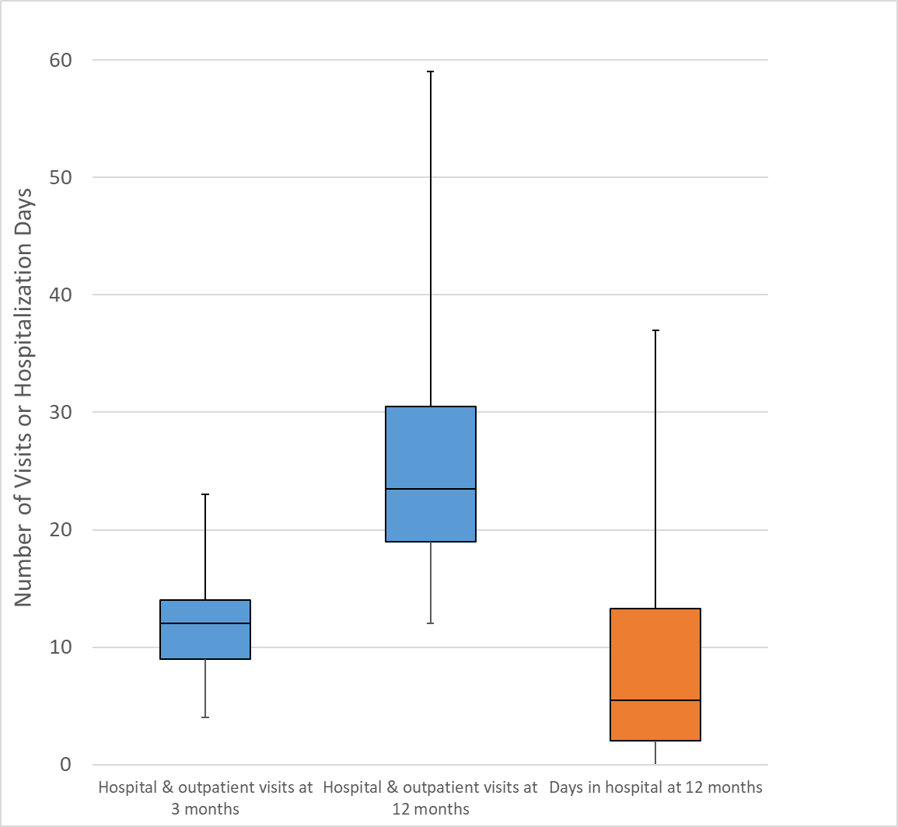
Median healthcare utilization in first year post-transplant
Notes:
Katie: In looking at healthcare utilization in this population over the first year post-transplant, we found that the median number of hospital and outpatient department visits at 3 months was 12, and at 12 months was 24, but with some outliers who had as many as 59 visits in the first 12 months. The median days in hospital for this population in the first year post-transplant was only 6.

Slide 30
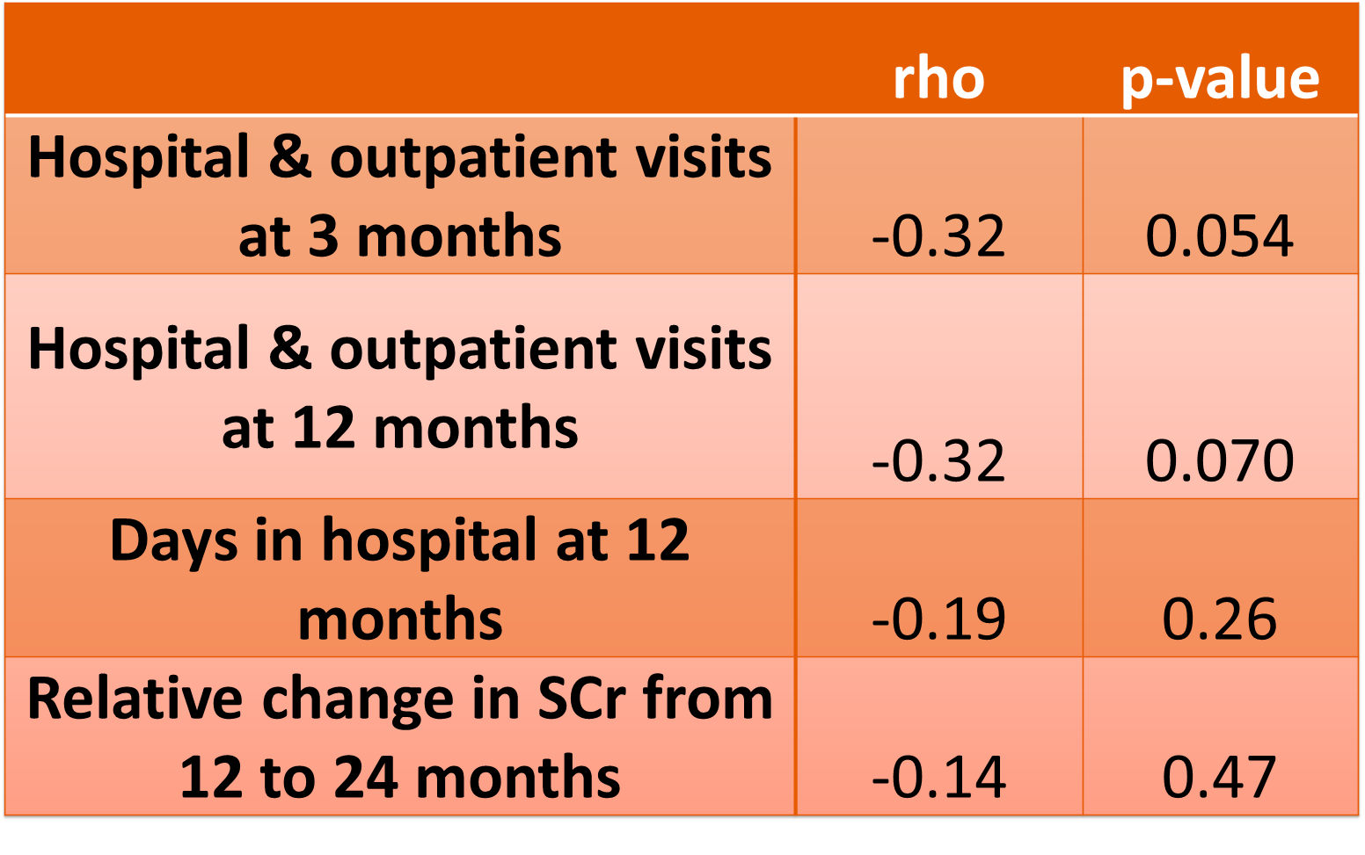
Health literacy, healthcare utilization & allograft outcomes
HELP-KIDNEY
Notes:
Katie: when we looked at the health care utilization data and its association with health literacy scores, we found no statistically significant correlation, but a trend towards increased visits in the early post transplant period. There was no clear association between days spent in hospital.
When we explored the change in graft function for patients in whom we had data up to 24 months post-transplant, we found no significant correlation between kidney function and health literacy level. It is likely that a 2 year period post-transplant was insufficient to see a meaningful change in graft function in the majority of patients, and that a longer follow-up is needed to capture a relationship, if one exists. Our results did not indicate any association between lower health literacy and early graft decline, however.
Note: statistic test used for analysis: spearman non-parametric test

Slide 31
Conclusion:
Low caregiver health literacy showed an associated trend with higher healthcare utilization post-transplant, but did not meet statistical significance
Low health literacy was not predictive of increased days hospitalized or change in SCr in the first years post-transplant in this analysis

Slide 32
Future Investigation:
Further analysis is planned to describe the relationship between health literacy and immunosuppressant medication adherence post-transplant
Opportunity for prospective study to assess efficacy of health literacy based interventions for families
Notes:
Katie

Slide 33
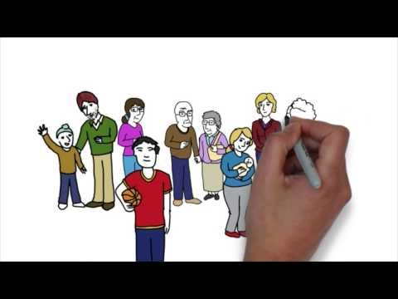
How will we use information about health literacy in our population?
Notes:
Kat:
So we’re going to share a short clip from an old video Vancouver Coastal produced back in 2009 to highlight some ways in which we recognise and then use information about health literacy to help our patients.
https://www.youtube.com/watch?v=_8w9kdcRgsI – watch from 3.54 on strategies to help improve health literacy within BC
Look for clues
Demonstrations
Audio-visuals
Highlight take home points
Use plain language

Slide 34
Successful initiatives from the literature:
AHRQ Health Literacy Universal Precaution Toolkit 2nd Edn
21 Tools (3-5 pages each) that address improving:
Spoken communication
Written communication
Self-management and empowerment
Supportive systems
Developed for roll out in primary care
Widely implemented
https://www.ahrq.gov/health-literacy/improve/precautions/toolkit.html
Notes:
Further testing needing, but studies so far revealed that the more concise tools that are not resource intensive to implement get utilized most (David et al 2010)
Use of the “Brown Bag Medication Review” which involves patients bringing all the medications in a bag to review with their health care provider, found drug therapy problems were more easily identified and resolved. (Weisse et al 2016)
The agency for health care research and quality releasde a universal precaution toolkit which lays out 21 tools to helpreduce the complexity of health care, increase patient understanding of health information, and enhance support for patients of all health literacy levels. They target areas of spoken and written communication, self management and empowerment, supportive systems.

Slide 35
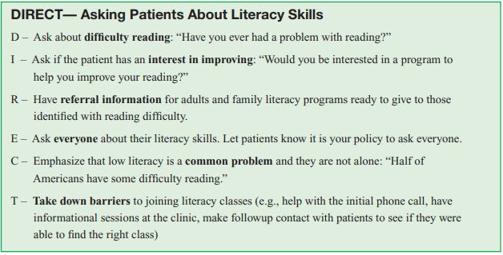
AHRQ Health Literacy Universal Precaution Toolkit 2nd Edn
https://www.ahrq.gov/health-literacy/patient-education/pemat.html

Slide 36
“Teach Back” Method in Pediatric Transplant Recipients
Computer-based program developed for adolescent and young adult kidney transplant recipients (13-21 yo) to answer questions about their health & medications
Health literacy screening (REALM-Teen) conducted pre-intervention (44% below-grade level)
Patient Educ Couns. 2019 May;102(5):1035-1039
Notes:
Kat: Heard from our parent partner that having to “teach others” if often a necessity for patient family members (eg. teaching the school, teaching other family members that may assist in providing care). Literature shows that using this “teach-back” approach may actually help greatly to solidify knowledge in those of all literacy levels

Slide 37
“Teach Back” Method in Pediatric Transplant Recipients
Questionnaires and informational videos built into software, repeated @ 2 clinic visits
Assessment @ baseline and @3 months
Statistically significant increase in overall knowledge of names (p=0.0002) and purpose (p=0.0017) of medications
Key features of this intervention that benefit those with lower health literacy:
Active learning participation
Use of visual aids and multi-media
Spaced repetition of learning
Patient Educ Couns. 2019 May;102(5):1035-1039
Notes:
Kat

Slide 38
Patient Educ Couns. 2019 May;102(5):1035-1039
Notes:
Kat

Slide 39
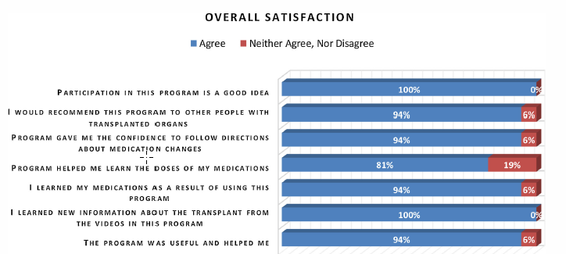
Patient Educ Couns. 2019 May;102(5):1035-1039
Notes:
Kat: highlight that participants thought the program was help / a good idea

Slide 40
Incorporating these principles into our program
Spaced repetition of learning:
Foundational medication and transplant care teaching incorporated into pre-transplant assessment process
Individualized, formative medication teaching at the time of transplant
Integrating formative teaching into clinic visits (eg. transition-specific preparation clinics)
Use of visual aids and multi-media
Eg. Immunosuppressant “force-field”
Medication calendars
Active learning participation
“Fill in the blank” interactive component at time of pre-transplant teaching
Future planning to reinvigorate post-transplant teaching tools and platform for more active participation
Notes:
Katie: Many of the above were mentioned by our parent partner: eg. the value of real-time conversation/education during clinic visits

Slide 41
Medication after transplant: fill in the blank
Anti-rejection transplant medications must be taken ____________ (for how long?)
Transplant medications have possible side effects, such as _____________ and ______________
The benefits of keeping your transplant healthy outweigh the risks of using these medications
Transplant medications must be taken _______________________
(how often?)
Other medications may be needed after transplant, such as medication for ______________________________

Slide 42
Tacrolimus (TAC)
Mycophenolate (MMF)
Corticosteroids (Methylprednisolone, prednisone)

Slide 43
x
REJECTION

Slide 44
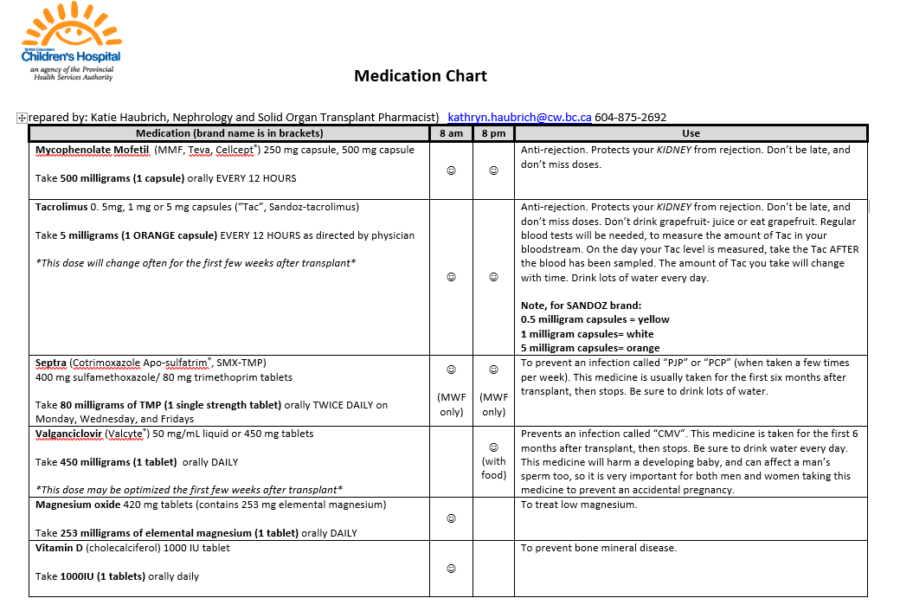

Slide 45
Case examples
Case 1:
Brett is an almost 18 yo with profound hearing loss. He had a kidney transplant following a diagnosis of FSGS. His grandmother was his primary caregiver and shared that he had difficulty taking on parts of his care after years of her taking the lead in his health care management.
The team worked with Brett and considered his health literacy and made adaptations accordingly.
NVS screening with Brett revealed possibility of limited literacy.
Notes:
Kat:
- including pictorial medication lists
- care plans for health care staff (including always having an ASL interpreter present, and not using a family member)
- use of email and text messaging

Slide 46
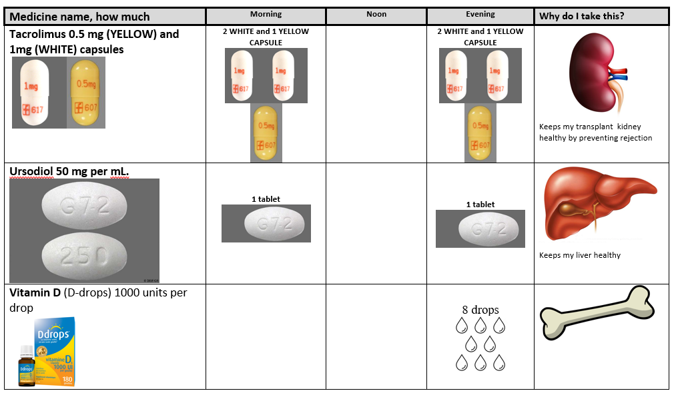
Pictoral Medication List

Slide 47
Case examples
Case 2:
Shota is a 14yo refugee from Iran who recently arrived in Canada with end stage kidney disease and is currently on dialysis. Both his parents are deceased and he is cared for by a supportive adult cousin.
The team expressed concern about the Shota and his cousin’s health literacy based on English being their second language. Shota and his cousin often said very little during interactions with health care professionals but were largely compliant with his dialysis care.
NVS screening (done with an interpreter present) indicated likely adequate literacy.
Notes:
Katie:
Considered bias: assumptions made with English as second language
English language proficiency can impact health literacy, but is not always predictive of health literacy.
Screened NVS via interpreter with cousin- adequate literacy
Completed teaching with cousin and Shota with an interpreter present
Used teach back method, visual aids, medication calendar with symbols or translated information
Considered further neurocognitive/neuropsychological testing

Slide 48
Case examples
Case #3:
Nora is a 3 yo on dialysis awaiting a kidney transplant.
Her mother is a health care worker and Nora’s primary caregiver. Nora was attending dialysis regularly but there were some ongoing medication errors at home that were causing blood pressure instability. The team had not been giving updated medication lists and had assumed that Nora’s mother was “on top” of keeping things organized at home.
NVS screening indicated that Nora’s mother had a high likelihood of limited health literacy.
Notes:
Kat:
- Consider bias and need for screening regardless
-Tailor education accordingly
- Manage shame around literacy with sensitivity.

Slide 49
Summary
Limited health literacy is common across all groups including solid organ transplant
Lower health literacy is associated with poor health outcomes
Assessing health literacy using validated tools can easily be incorporated into any practice area
There is a gap in understanding the impact of health literacy on health outcomes in the pediatric transplant population
Lower health literacy associated with a trend towards increased healthcare utilization at our center
There is a need for practices and tools to support families and patients within their literacy abilities
Opportunities exist within transplant programs to enhance the care we provide within the context of health literacy
Notes:
Kat:

Slide 50
Many thanks to:
Research collaborators: Tatsuma Hind and Tom Blydt-Hansen
Parent partner: Aleksandra
Our BCCH MOT Team and Families for their support of this initiative

Slide 51
References
Public Health Agency of Canada: A vision for a health literate Canada; report of the expert panel on health literacy (2017). Available from: https://www.cpha.ca/vision-health-literate-canada-report-expert-panel-health-literacy
Rosas-Salazar C, Ramratnam SK, Brehm JM, Han Y-Y, Acosta-Pérez E, Alvarez M, et al. Parental numeracy and asthma exacerbations in Puerto Rican children. Chest. 2013 Jul;144(1):92–8
DeWalt DA, Dilling MH, Rosenthal MS, Pignone MP. Low parental literacy is associated with worse asthma care measures in children. Ambul Pediatr Off J Ambul Pediatr Assoc. 2007 Feb;7(1):25–31.
Macy ML, Davis MM, Clark SJ, Stanley RM. Parental health literacy and asthma education delivery during a visit to a community-based pediatric emergency department: a pilot study. Pediatr Emerg Care. 2011 Jun;27(6):469–74
Morrison AK, Schapira MM, Gorelick MH, Hoffmann RG, Brousseau DC. Low caregiver health literacy is associated with higher pediatric emergency department use and nonurgent visits. Acad Pediatr. 2014 Jun;14(3):309–14.
Yin HS, Mendelsohn AL, Wolf MS, Parker RM, Fierman A, van Schaick L, et al. Parents’ medication administration errors: role of dosing instruments and health literacy. Arch Pediatr Adolesc Med. 2010 Feb;164(2):181–6.
Yin HS, Dreyer BP, Ugboaja DC, Sanchez DC, Paul IM, Moreira HA, et al. Unit of measurement used and parent medication dosing errors. Pediatrics. 2014 Aug;134(2):e354–61
Bailey SC, Pandit AU, Yin S, Federman A, Davis TC, Parker RM, et al. Predictors of misunderstanding pediatric liquid medication instructions. Fam Med. 2009 Dec;41(10):715–21.
Lokker N, Sanders L, Perrin EM, Kumar D, Finkle J, Franco V, et al. Parental misinterpretations of over-the-counter pediatric cough and cold medication labels. Pediatrics. 2009 Jun;123(6):1464–71.
Storms H, Aertgeerts B, Vandenabeele F, et al General practitioners’ predictions of their own patients’ health literacy: a cross-sectional study in Belgium BMJ Open 2019;9:e029357.
Weiss B. D. Mays M. Z. Martz W. Castro K. M. DeWalt D. A. Pignone M. P. Hale F. (2005). Quick assessment of literacy in primary care: The Newest Vital Sign. Annals of Family Medicine, 3(6), 514–522.10.1370/afm.405
Chandar JJ, Ludwig DA, Aguirre J, Mattiazzi A, Bielecka M, Defreitas M, Delamater AM. Assessing the link between modified 'Teach Back' method and improvement in knowledge of the medical regimen among youth with kidney transplants: The application of digital media. Patient Educ Couns. 2019 May;102(5):1035-1039
Shoemaker SJ, Wolf MS, Brach C. Development of the Patient Education Materials Assessment Tool (PEMAT): a new measure of understandability and actionability for print and audiovisual patient information. Patient Educ Couns 2014;96(3):395-403

Slide 52
Questions?
kathryn.haubrich@cw.bc.ca
katherine.broad@cw.bc.ca

