Slide 1
Daytime is better … nothing else makes sense
Sean Keenan MD
October 24, 2023
BC Transplant Education Days

Slide 2
Disclosures
Provincial Medical Director, Donation Services, BC Transplant

Slide 3
Acknowledgements
John Yee
Stephen Chung
Peter Kim
Maya Segedi
Stephanie Chartier Plante
Jim Able
Mark Nigro
Mark Meloche
Jamil Bashir
Mike Eng
Chris Nguan
Dave Harriman
Brian Mason
Dean Chittock
Ron Carere
Marcel Dvorak
Stephen Reynolds
Kenneth Ryan
Brian Yang
Andrew Sawka
Jim Able
Eric Lun
Heidi Butler
Kiran Khatar
Ed Ferre

Slide 4
Acknowledgements
Fraser Health Authority
RCH, SMH, ARH, BH
Vancouver Island
RJH, VGH
Interior Health
KGH, RIH
Northern Health
UHNBC
PHSA
BCCH
Providence
SPH
Vancouver Coastal
VGH
LGH

Slide 5
Objectives today
Explain why transplant were done at night
HOW DID WE GET HERE?
Build a rationale for change
WHY DO WE NEED TO DO THESE SURGERIES DURING THE DAY
Describe our approach … change ideas in action
Present our results to date
Discuss our ongoing challenges

Slide 6
History of Deceased Organ Transplantation in British Columbia
First kidney transplant – October 24, 1968
First heart transplant - 1988
First liver transplant - 1989
First lung transplant - 1989

Slide 7
Deceased Organ Donors in British Columbia
IHC/DP/DCD
Heart, Liver, Lung Transplant begins
Opiate Crisis

Slide 12
Why were transplants done overnight?
All programs began with low volumes
All surgeons had full clinical practice with transplant more of an add on practice
Organ recovery arranged in evening after completion of the day duties
Organ implant would follow this, usually through the night

Slide 13
Why should organ transplants happen during the day?
What is the Rationale for Change
Patients/Families/Caregivers
Healthcare workers … Surgical Teams, ORs, ICUs
Cost Avoidance
Cost Reduction

Slide 14
Is there a need to build a rationale for this?
Who would argue with the need for complex, long surgeries on high-risk sick patients happening during the day?
Would you want anything else for someone you knew?

Slide 15
Can you show me/us the evidence in the literature to support this?
Confirmation Bias
The tendency to search for, interpret, favour, or recall information in a way that confirms or supports one’s prior beliefs or values
Belief vaccines are bad …
Cryptocurrencies
Conspiracy theories in general
But need to be aware of this when we interpret the literature

Slide 16
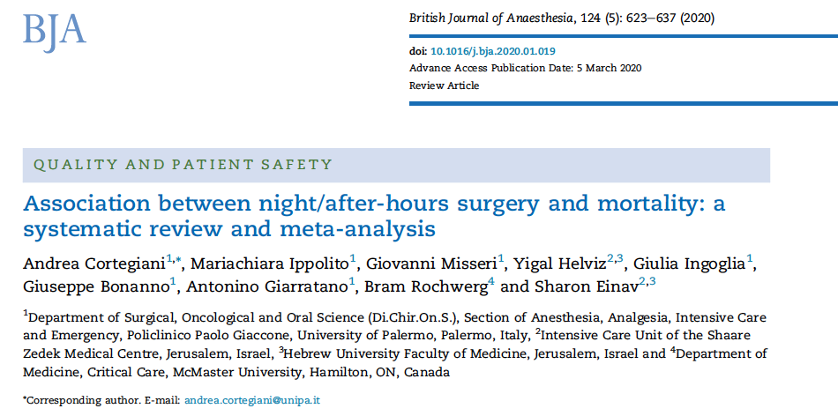
Overall, increased in mortality for night-time surgery
Urgency of surgery hard to control for so not adjusted

Slide 17
In Transplant subgroup no signal for difference in mortality

Slide 18
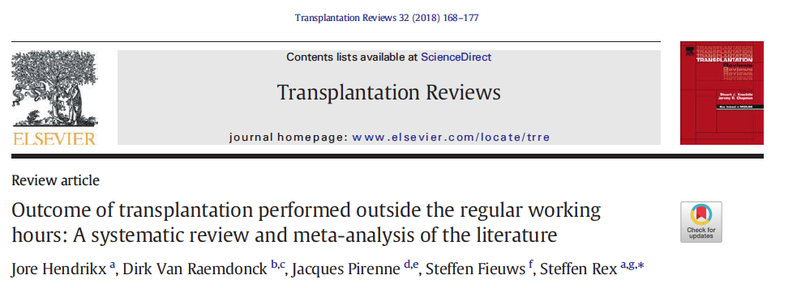

Slide 19
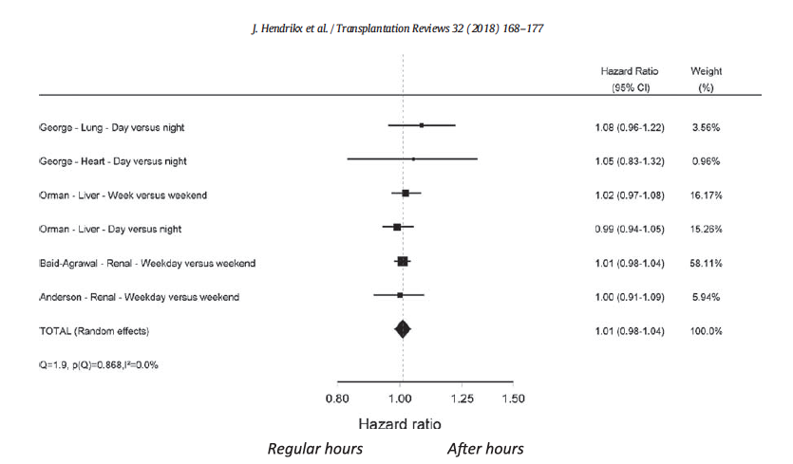

Slide 20
Compared day (3 am – 3 pm start) to night (3pm-3am start)
Unadjusted analyses
Increased short term mortality
Increased transfusions
No different in longer term mortality

Slide 21
St. Louis, Missouri
Reduction in blood products
Increased in-OR extubation

Slide 22
No difference in outcomes

Slide 23
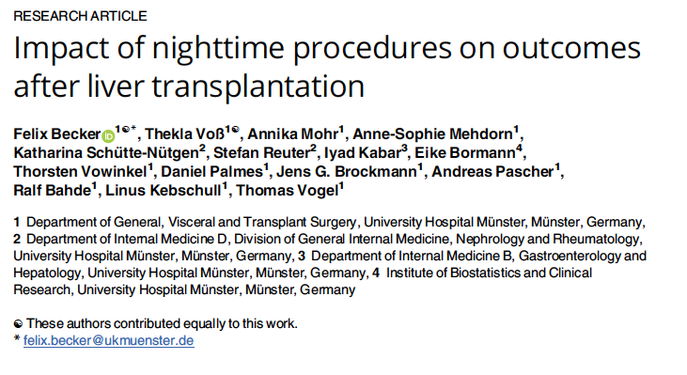
No difference in outcomes

Slide 24
No difference in day vs night surgery
No difference in outcomes

Slide 25
No difference in outcomes

Slide 26
No difference in outcomes

Slide 27
Lungs reperfused between 04:00-07:59 had higher primary graft dysfunction

Slide 28
Increase in graft failure
Increase in re-operation

Slide 29
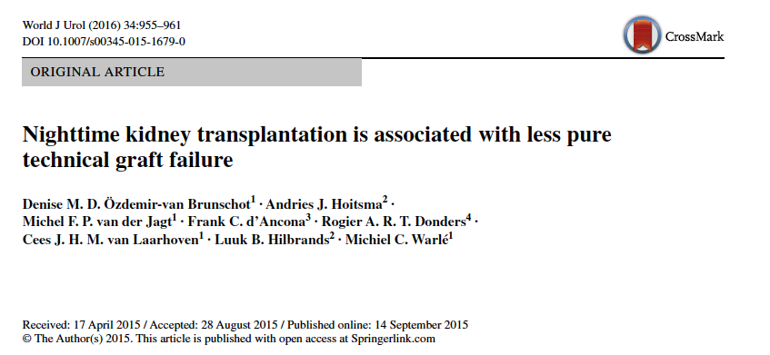

Slide 30
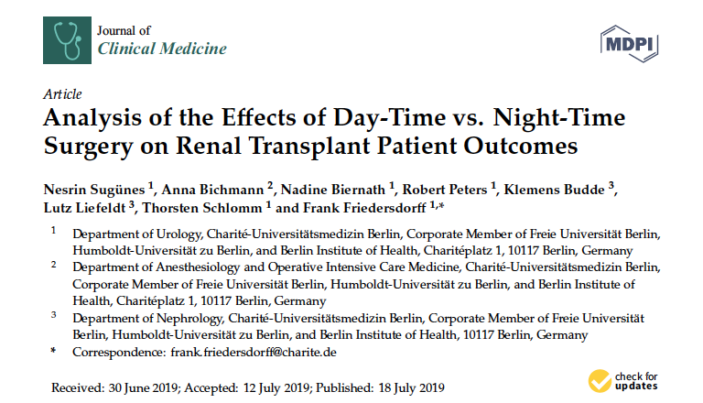
Increase in deaths for daytime surgery
No difference in other outcomes

Slide 31
No difference in outcomes

Slide 32
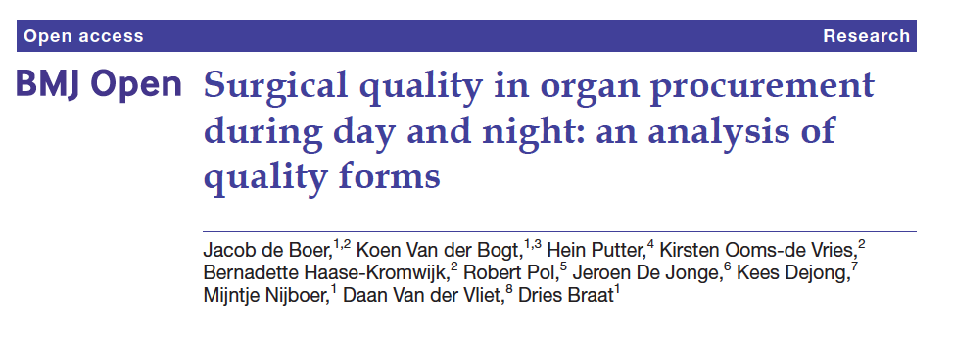
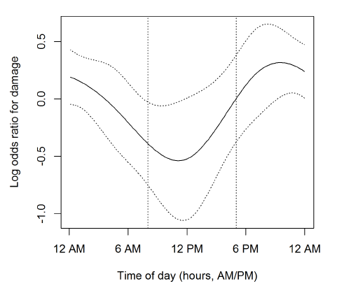

Slide 33
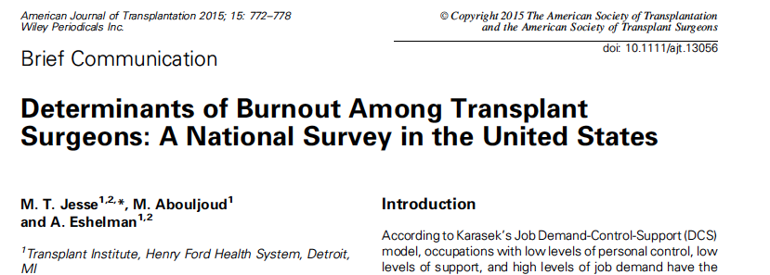

Slide 34
How can there not be better outcomes?
Surgeons / surgical teams do everything they can to prevent it
Bad outcomes rare … not realistic to expect they will be easily detectable

Slide 35
Night vs daytime surgery - Rationale for change
Rare, catastrophic events
Recipient outcomes
Program morale
Program recruitment & retention
Impact on other overnight, emergent surgeries
Impact on OR next day
Cost implications … soft green dollars/cost avoidance

Slide 36
Surgical Optimization Project/ OR access project

Slide 37
Background
Multiple Ad hoc meetings over 2018 and 2019
VGH introduced daytime access for organ recovery
No Plan beyond this
Recovery Surgeons variable availability
Donor ORs not able to support

Slide 39
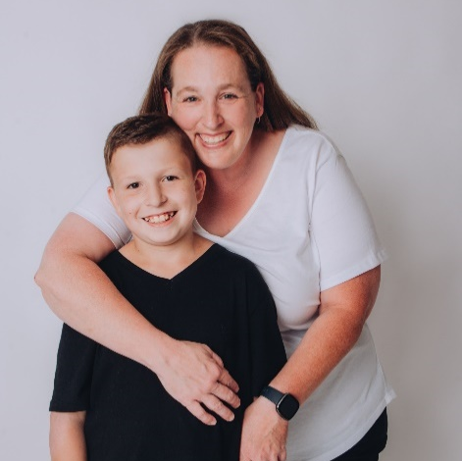
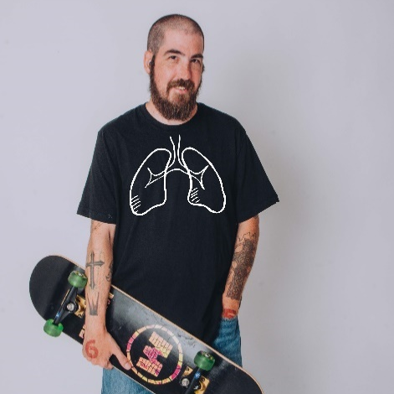
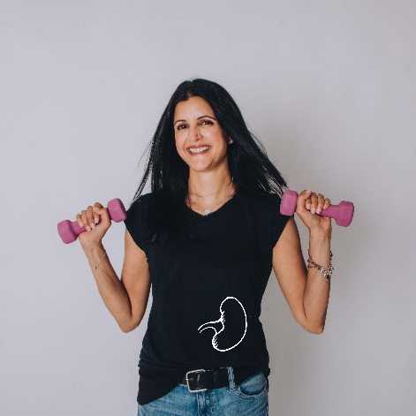
Original Project Goals
Donor recovery surgeries at donor sites will occur at targeted start times between 0700- 1400 hrs (when air travel required, 0800 – 1400 hrs).
Goal 80% donor recoveries NDD/ DCD
Implants surgeries at transplant sites will occur at targeted start times between 0900 – 1800 hr.
Goal 80% transplant surgeries
Should be striving for optimal timing 100% of the time
(especially when highly complex and sick recipients identified)

Slide 40
Challenges

Slide 41
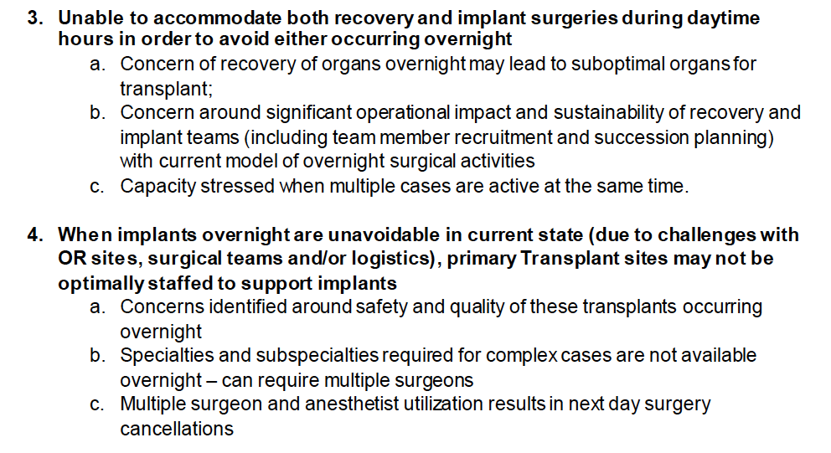
Challenges

Slide 42
Challenges

Slide 43
Challenges

Slide 44
Night vs Daytime surgery
Impact on Donor Site OR
Need to cancel or “bump” booked case(s)
Unable to meet MOH expectations for non-transplant surgeries
Upset of local surgical teams
Potential negative impact on support of donation/transplant

Slide 45
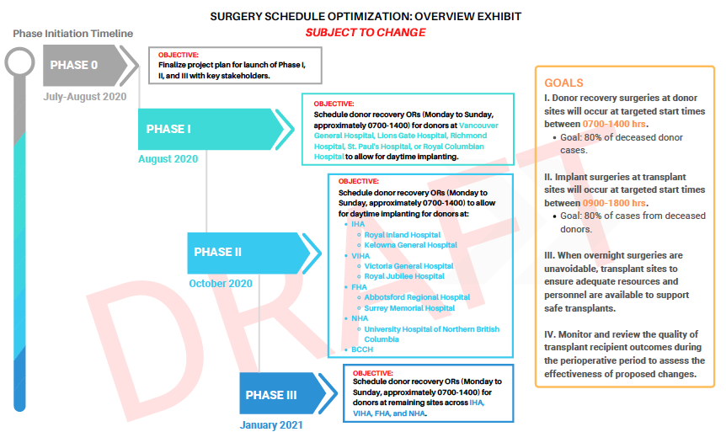

Slide 46
Our QI “Intervention”

Slide 47
How are we doing?

Slide 48
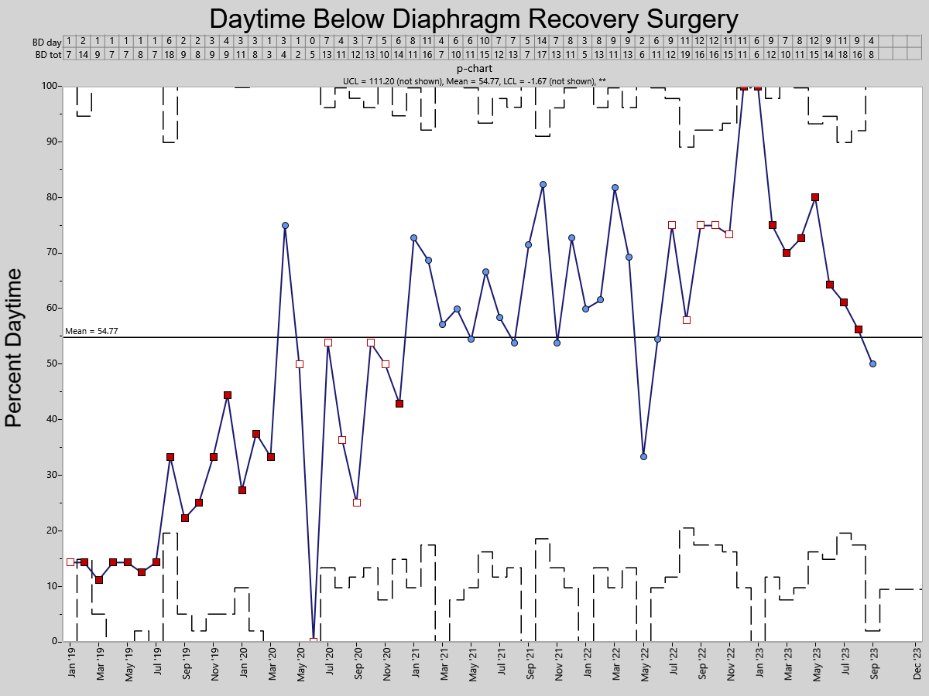

Slide 49
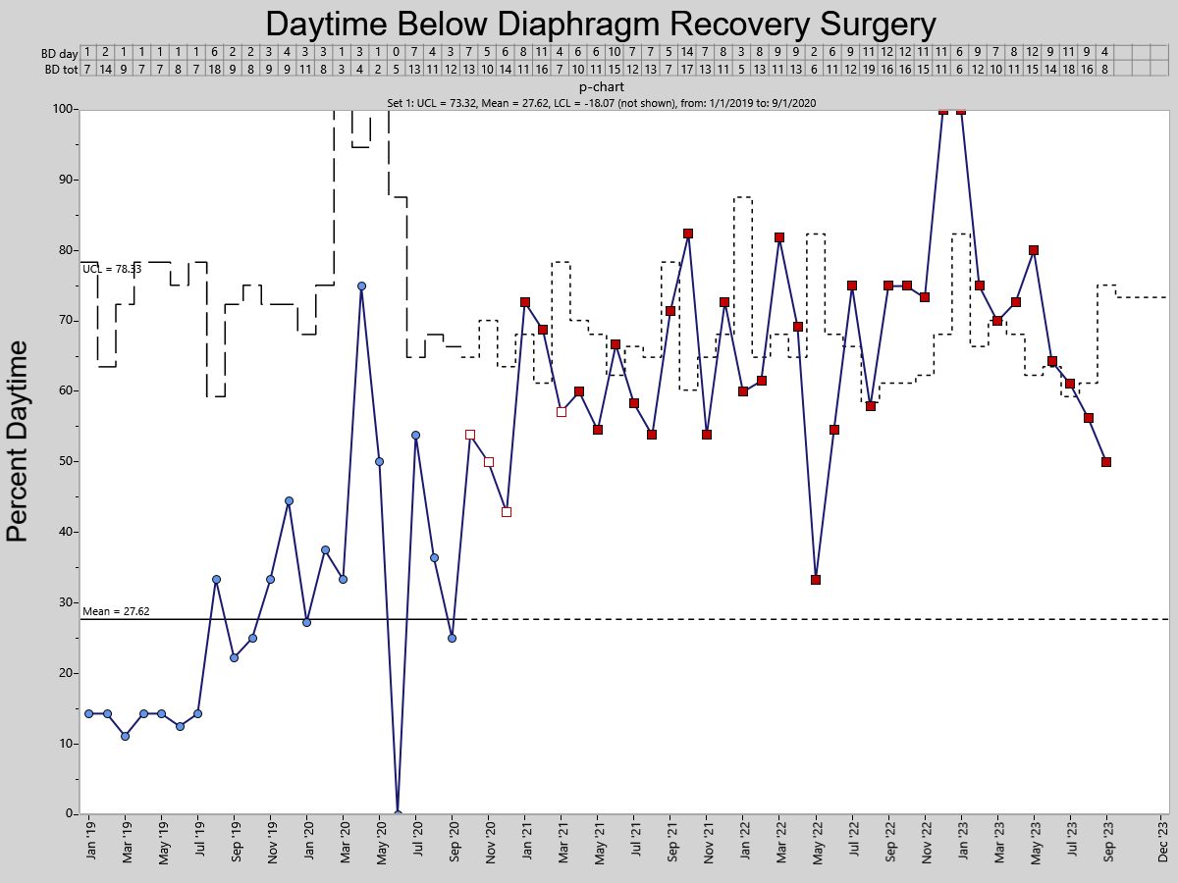

Slide 50
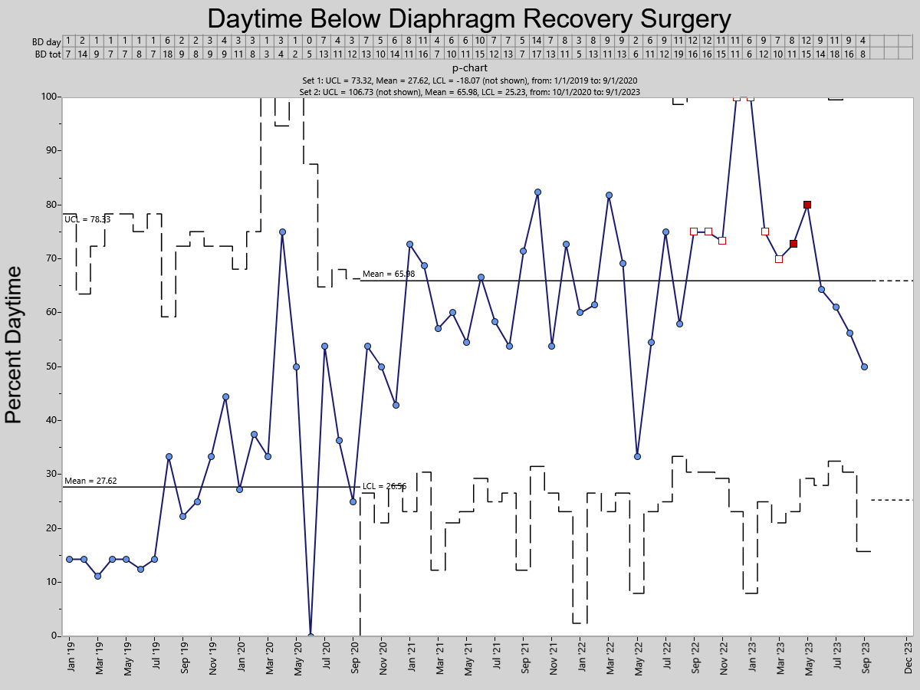

Slide 51
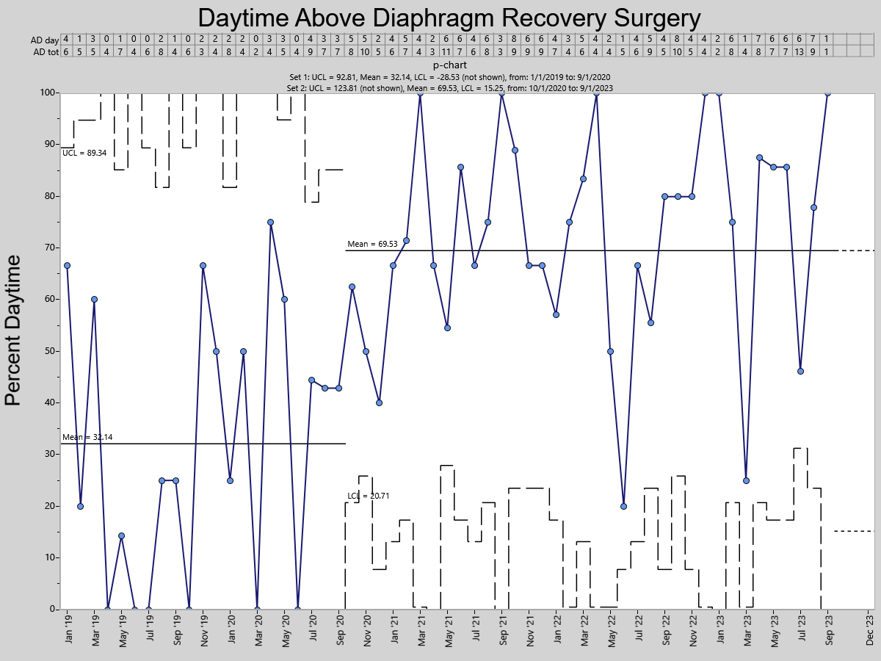

Slide 52
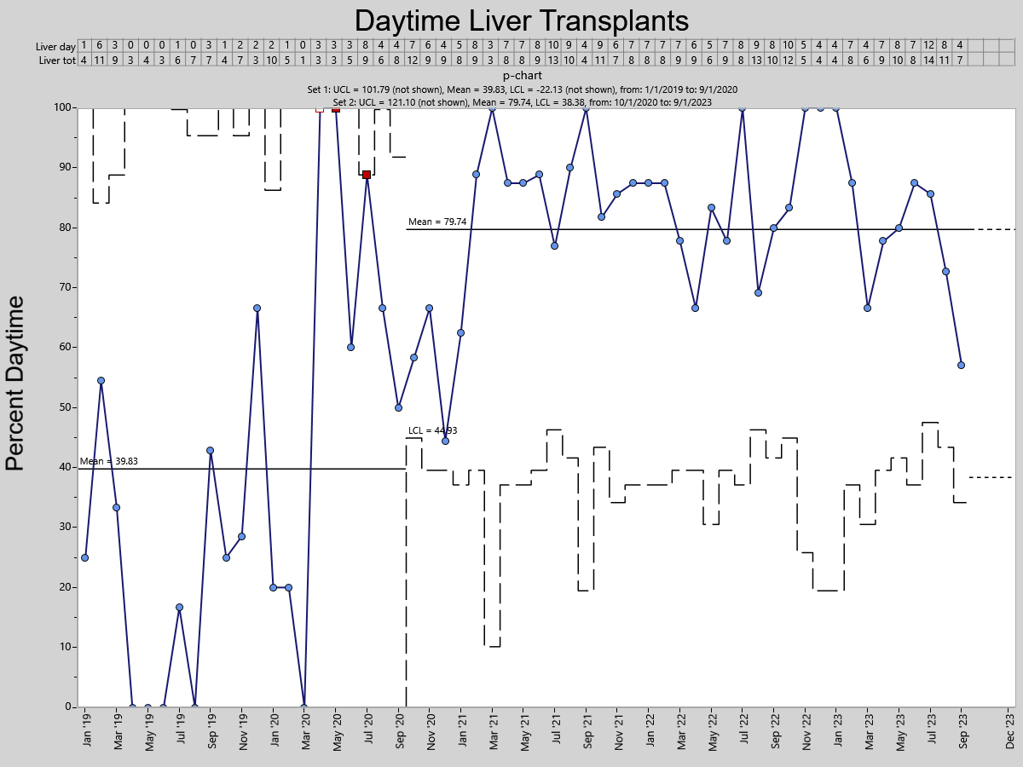

Slide 53
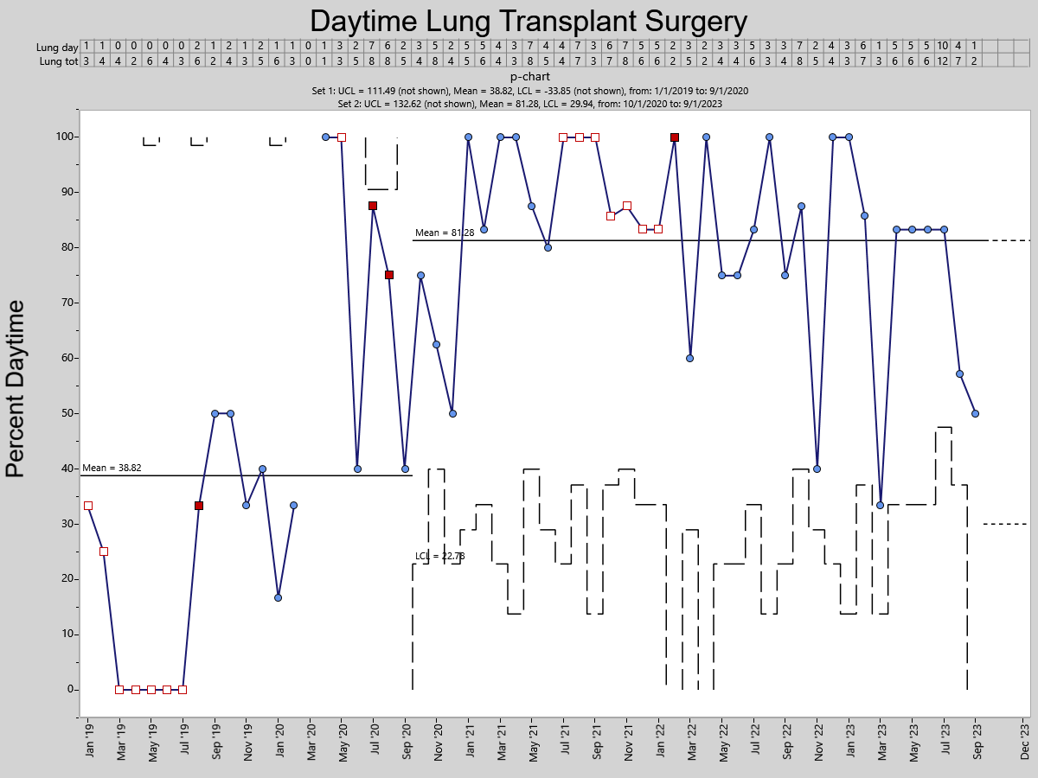

Slide 54
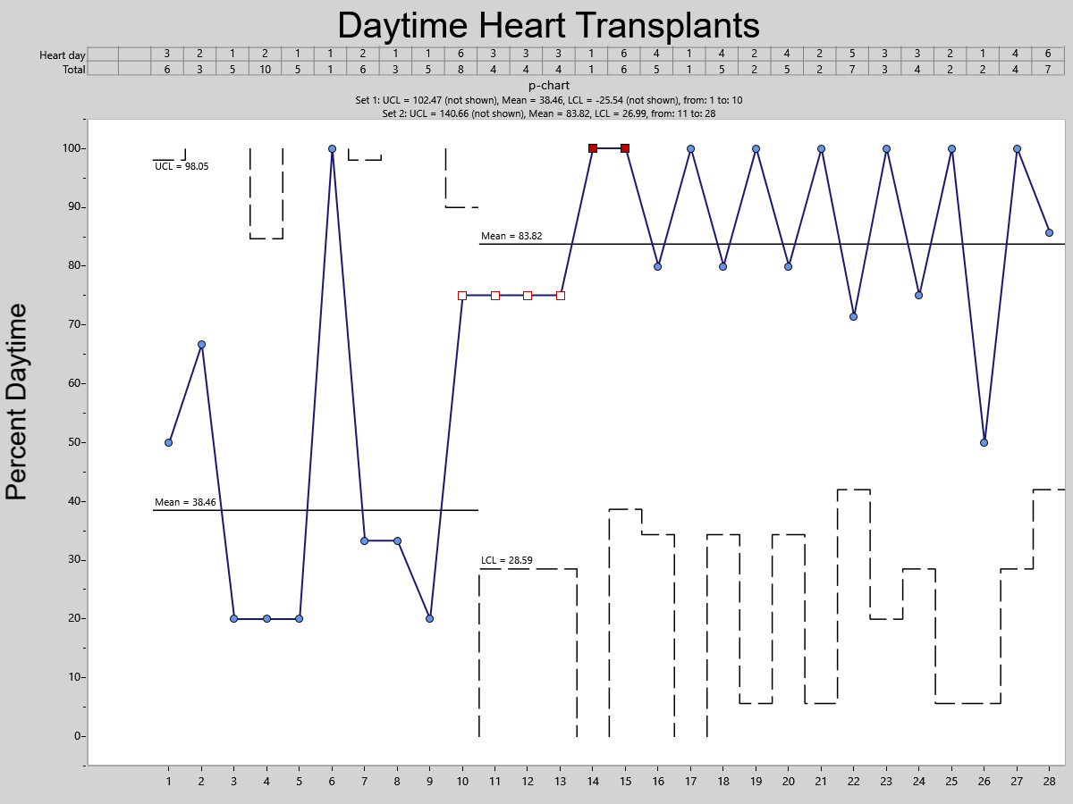

Slide 55
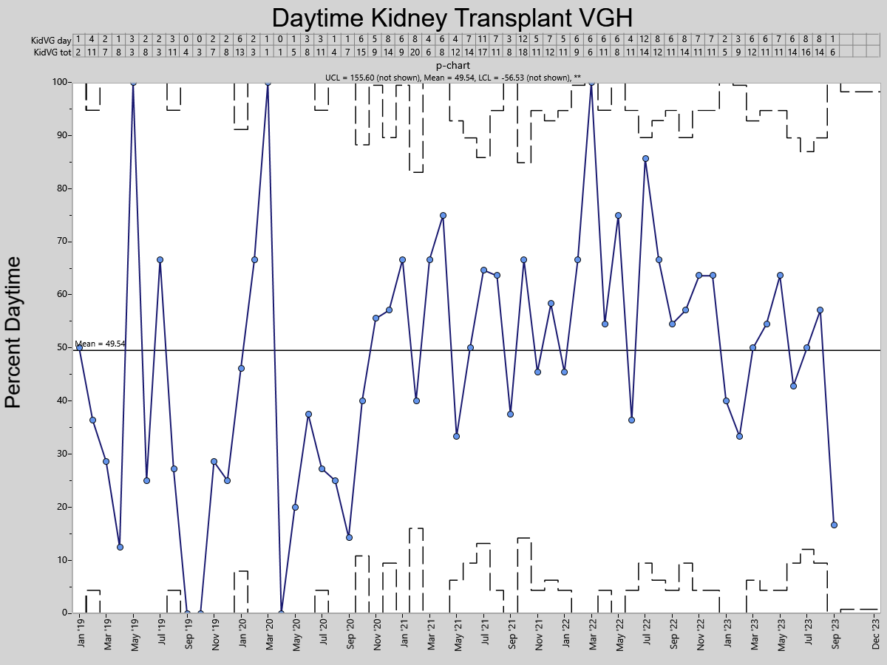

Slide 56
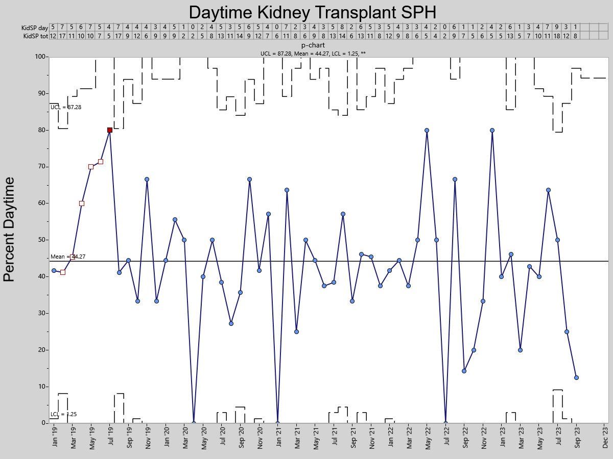

Slide 57
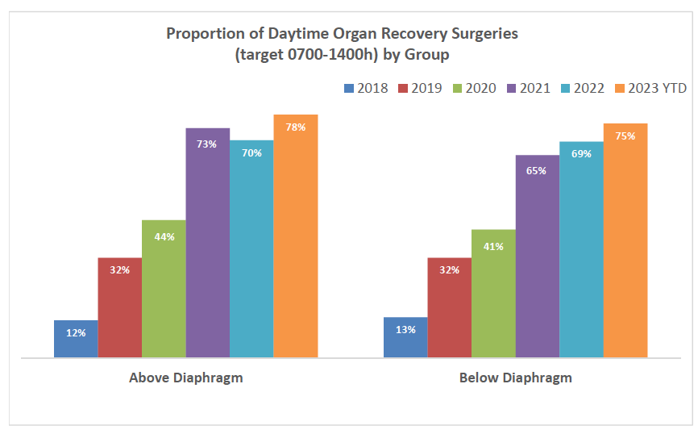

Slide 58
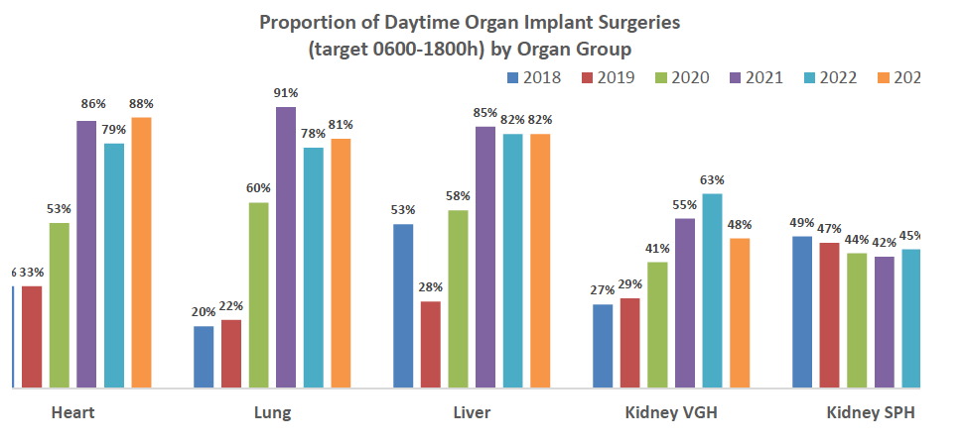

Slide 59
Summary
Positive Results
Increase proportion of patients receiving heart, lung and liver transplants during the day
Increase in daytime recovery surgery
Improved morale among transplant teams … sustainability
Saved $$ for the system … soft green dollars

Slide 60
Summary
Ongoing concerns / learnings
Variable uptake/support for change within BC
Intense pressure BC hospitals are under, especially ORs
Success dependent upon good will of key people
What happens if key people don’t support?
What happens if supportive key people move on?
Need to build into system a way to maintain gains

Slide 61
Thank you!

